Slide 1

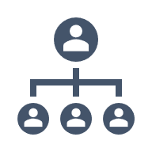

25th International Master in Plant Genetics, Genomics and Breeding
Unit 7: Marker enabled prediction and selection
IBD, IBS, Genetic Distance, Population Structure
Feb 12 – 13, 2026
CJ Yang
cjyang90@uwalumni.com
cjyang-work.github.io

Slide 2
Lecture outline
Background & introduction
Identity-by-descent (IBD)
Identity-by-state (IBS)
Genetic distance
Population structure
Summary
Concepts
Examples
Applications
Challenges

Slide 3
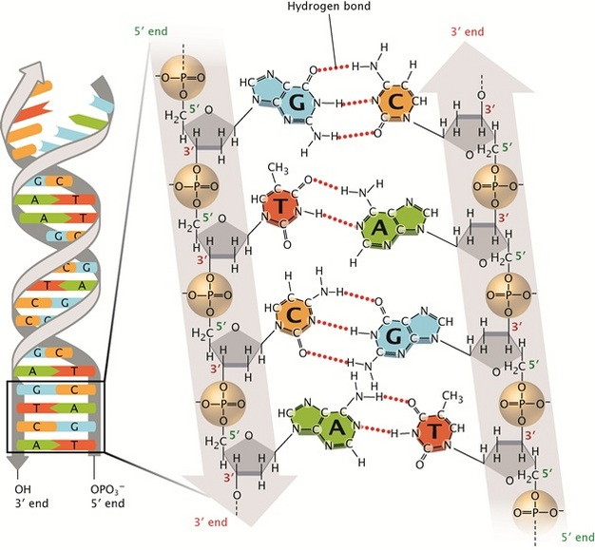
Background
Mendelian genetics
DNA
Recombination
A
a
A
a
Dominant vs recessive alleles
Pray L (2008)

Slide 4
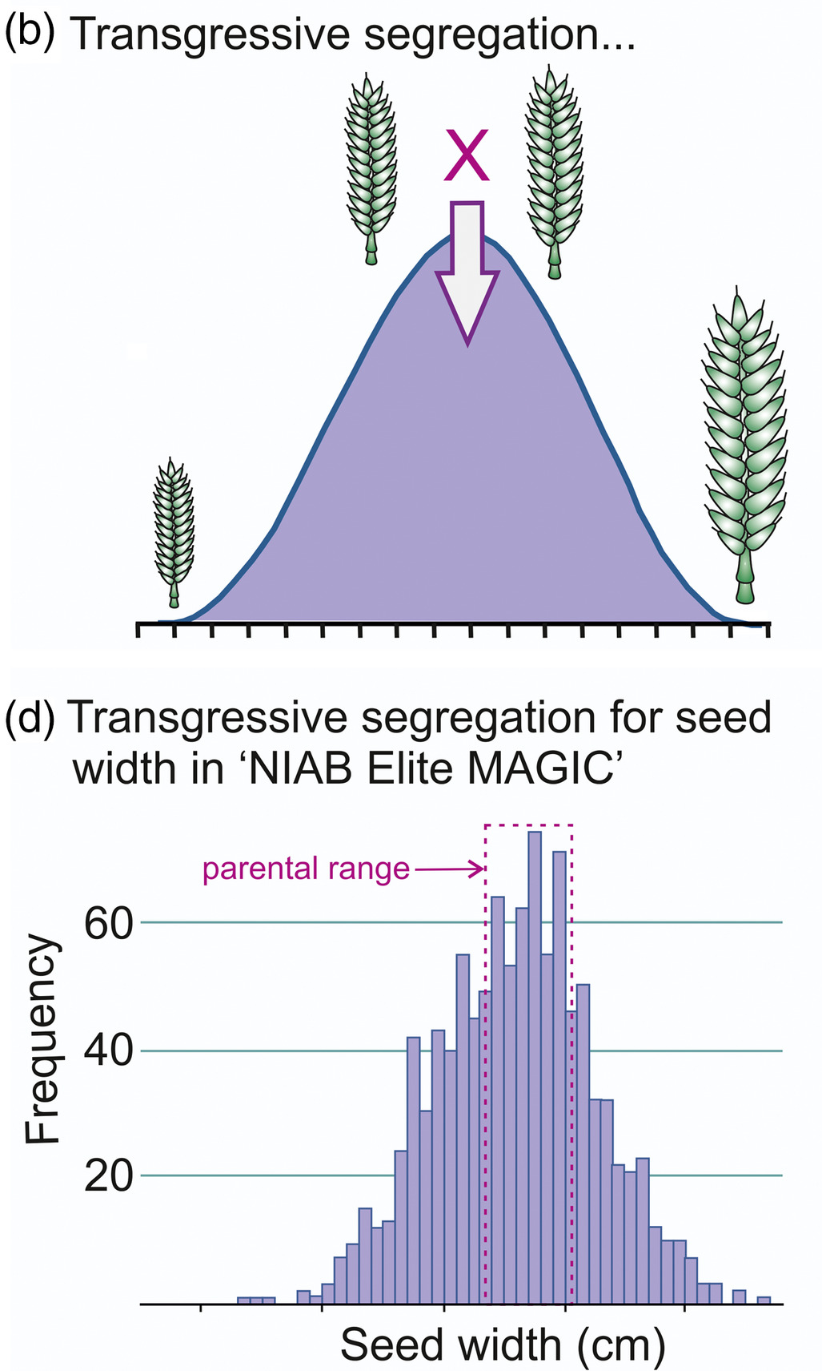
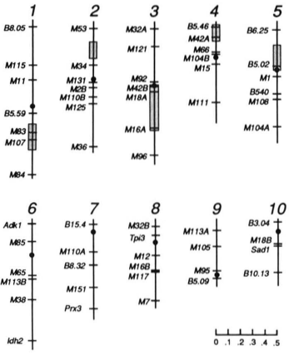
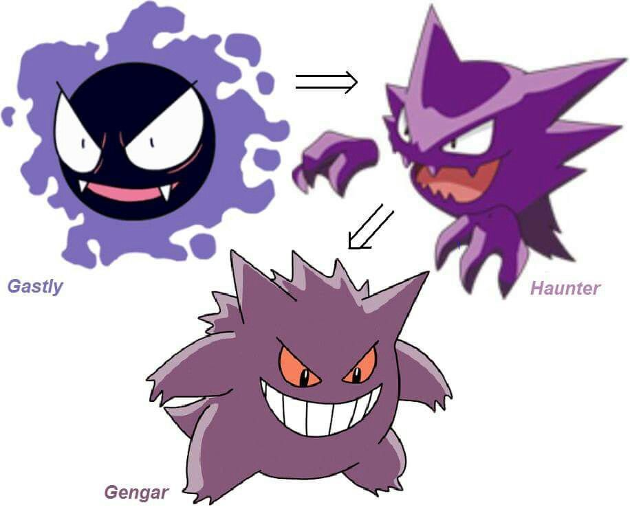
Background
Genetic linkage
Quantitative traits
Evolution
https://www.pinterest.com/pin/570620215266518401/
Doebley and Stec (1991)
Mackay et al (2021)

Slide 5
Motivation for understanding genetic relationships
Characterization of evolutionary history, selection, domestication, adaptation.
Population demographic inference, population admixture, bottleneck.
Mapping QTLs and genes.
Estimating variance components (h², V_{g}, V_{gxe}, r_{g}, etc…) in complex traits.
Polygenic background correction/control.
Genotype imputation and haplotype phasing.
Pedigree reconstruction.
New method development.
Genetic diversity monitoring and management.
Optimal contribution selection.

Slide 6
Identity-by-descent (IBD)
“Two alleles that have originated from the replication of one single allele in a previous generation may be called identical by descent”
Falconer and Mackay (1996) Introduction to Quantitative Genetics
AB
CD
AB
CD
Example with 4 alleles
AC
AD
AC
AD
AA
AD
IBD
not IBD

Slide 7
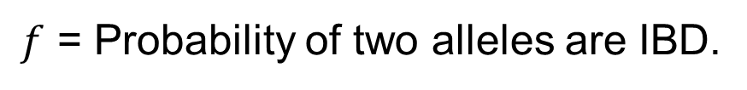
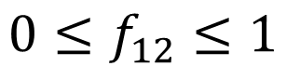
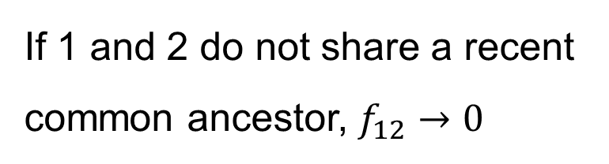
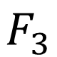
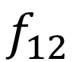
Coefficient of coancestry/consanguinity/kinship ($f$)
$f$ = Probability of two alleles are IBD.
$$f_{12}$$
1
2
$$0≤f_{12}≤1$$
If 1 and 2 do not share a recent common ancestor, $f_{12}→0$
3
$$F_{3}$$
Coefficient of inbreeding

Slide 8
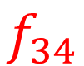
Example 1
1
2
3
4
$$f_{34}$$

Slide 9
Example 1
1
2
3
4
$$f_{34}$$
?
Hypothetical progeny

Slide 10
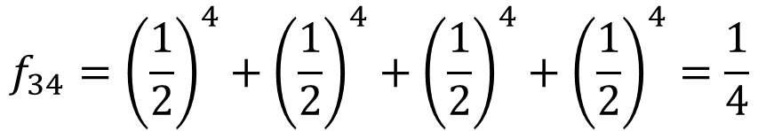
Example 1
AB
CD
AB
CD
AB
CD
AB
CD
½
½
A-
A-
B-
B-
C-
C-
D-
D-
½
½
AA
BB
CC
DD
$$f_{34}={\left(\frac{1}{2}\right)}^{4}+{\left(\frac{1}{2}\right)}^{4}+{\left(\frac{1}{2}\right)}^{4}+{\left(\frac{1}{2}\right)}^{4}=\frac{1}{4}$$
Dirty method

Slide 11
Example 2
1
2
3
4
5
6
7
8

Slide 12
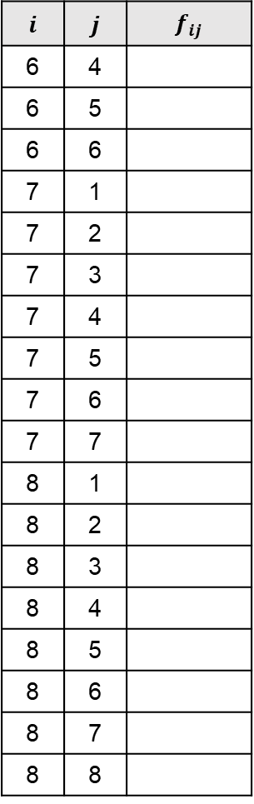
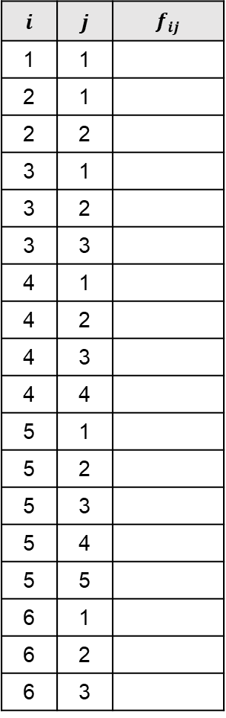
Example 2
1. Create a table and arrange it from oldest to youngest generations.
$$i$$ | $$j$$ | $$f_{ij}$$
1 | 1
2 | 1
2 | 2
3 | 1
3 | 2
3 | 3
4 | 1
4 | 2
4 | 3
4 | 4
5 | 1
5 | 2
5 | 3
5 | 4
5 | 5
6 | 1
6 | 2
6 | 3
$$i$$ | $$j$$ | $$f_{ij}$$
6 | 4
6 | 5
6 | 6
7 | 1
7 | 2
7 | 3
7 | 4
7 | 5
7 | 6
7 | 7
8 | 1
8 | 2
8 | 3
8 | 4
8 | 5
8 | 6
8 | 7
8 | 8
1
2
3
4
5
6
7
8

Slide 13
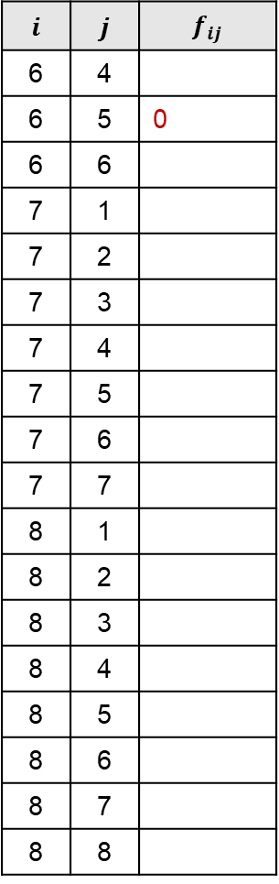
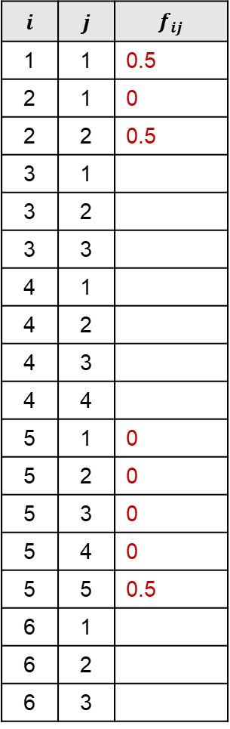
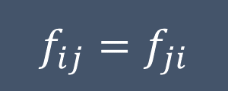
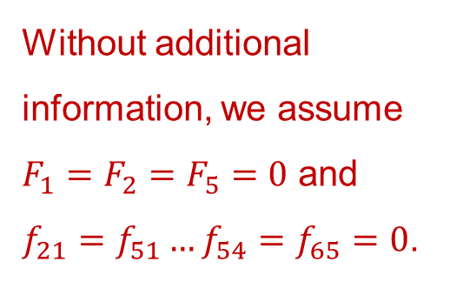
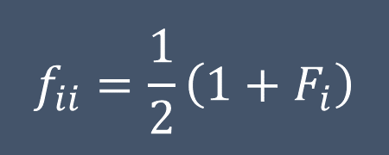
Example 2
2. Fill in the known and easy ones.
$$i$$ | $$j$$ | $$f_{ij}$$
1 | 1 | 0.5
2 | 1 | 0
2 | 2 | 0.5
3 | 1
3 | 2
3 | 3
4 | 1
4 | 2
4 | 3
4 | 4
5 | 1 | 0
5 | 2 | 0
5 | 3 | 0
5 | 4 | 0
5 | 5 | 0.5
6 | 1
6 | 2
6 | 3
$$i$$ | $$j$$ | $$f_{ij}$$
6 | 4
6 | 5 | 0
6 | 6
7 | 1
7 | 2
7 | 3
7 | 4
7 | 5
7 | 6
7 | 7
8 | 1
8 | 2
8 | 3
8 | 4
8 | 5
8 | 6
8 | 7
8 | 8
1
2
Without additional information, we assume $F_{1}=F_{2}=F_{5}=0$ and $f_{21}=f_{51}…f_{54}=f_{65}=0$.
3
4
5
6
7
$$f_{ii}=\frac{1}{2}\left(1+F_{i}\right)$$
8
$$f_{ij}=f_{ji}$$

Slide 14

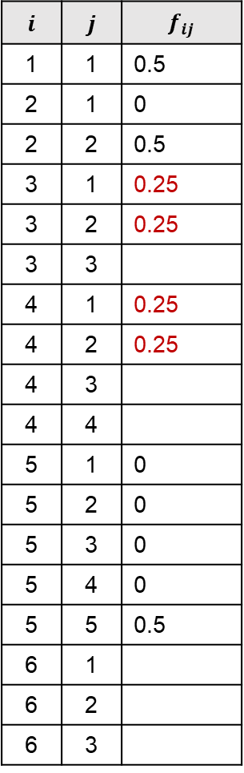
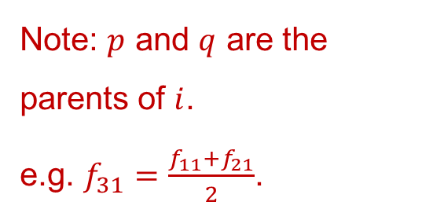
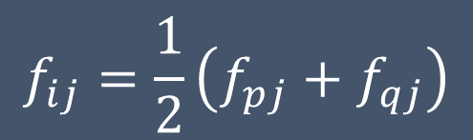
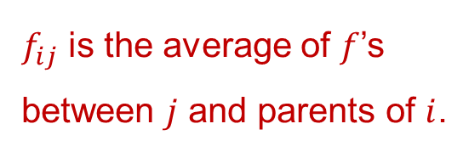
Example 2
3. Fill in the rest.
$$i$$ | $$j$$ | $$f_{ij}$$
1 | 1 | 0.5
2 | 1 | 0
2 | 2 | 0.5
3 | 1 | 0.25
3 | 2 | 0.25
3 | 3
4 | 1 | 0.25
4 | 2 | 0.25
4 | 3
4 | 4
5 | 1 | 0
5 | 2 | 0
5 | 3 | 0
5 | 4 | 0
5 | 5 | 0.5
6 | 1
6 | 2
6 | 3
$$i$$ | $$j$$ | $$f_{ij}$$
6 | 4
6 | 5 | 0
6 | 6
7 | 1
7 | 2
7 | 3
7 | 4
7 | 5
7 | 6
7 | 7
8 | 1
8 | 2
8 | 3
8 | 4
8 | 5
8 | 6
8 | 7
8 | 8
1
2
$f_{ij}$ is the average of $f$’s between $j$ and parents of $i$.
3
4
5
$$f_{ij}=\frac{1}{2}\left(f_{pj}+f_{qj}\right)$$
6
7
Note: $p$ and $q$ are the parents of $i$.
e.g. $f_{31}=\frac{f_{11}+f_{21}}{2}$.
8

Slide 15
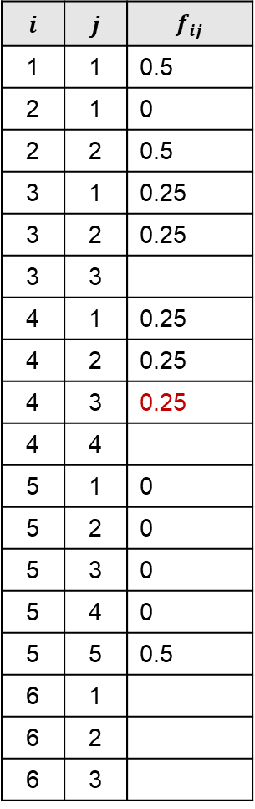
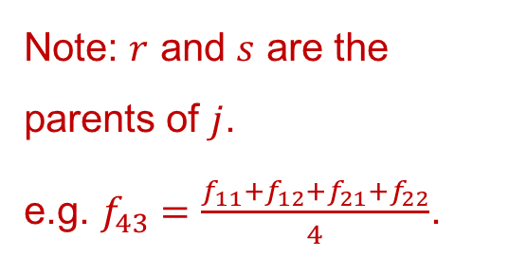
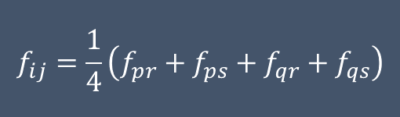
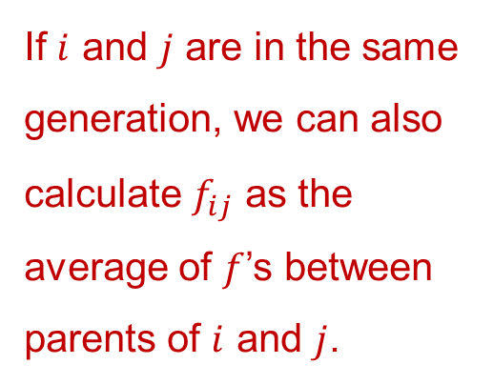
Example 2
If $i$ and $j$ are in the same generation, we can also calculate $f_{ij}$ as the average of $f$’s between parents of $i$ and $j$.
$$i$$ | $$j$$ | $$f_{ij}$$
1 | 1 | 0.5
2 | 1 | 0
2 | 2 | 0.5
3 | 1 | 0.25
3 | 2 | 0.25
3 | 3
4 | 1 | 0.25
4 | 2 | 0.25
4 | 3 | 0.25
4 | 4
5 | 1 | 0
5 | 2 | 0
5 | 3 | 0
5 | 4 | 0
5 | 5 | 0.5
6 | 1
6 | 2
6 | 3
$$i$$ | $$j$$ | $$f_{ij}$$
6 | 4
6 | 5 | 0
6 | 6
7 | 1
7 | 2
7 | 3
7 | 4
7 | 5
7 | 6
7 | 7
8 | 1
8 | 2
8 | 3
8 | 4
8 | 5
8 | 6
8 | 7
8 | 8
1
2
3
4
5
$$f_{ij}=\frac{1}{4}\left(f_{pr}+f_{ps}+f_{qr}+f_{qs}\right)$$
6
7
Note: $r$ and $s$ are the parents of $j$.
e.g. $f_{43}=\frac{f_{11}+f_{12}+f_{21}+f_{22}}{4}$.
8

Slide 16
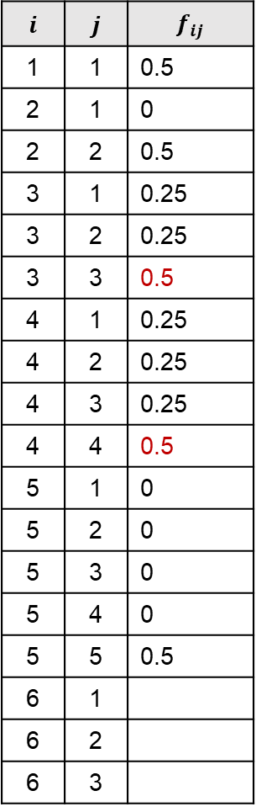
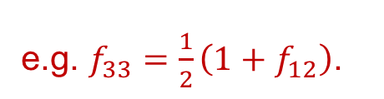
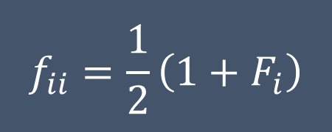
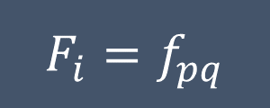
Example 2
Recall these.
$$i$$ | $$j$$ | $$f_{ij}$$
1 | 1 | 0.5
2 | 1 | 0
2 | 2 | 0.5
3 | 1 | 0.25
3 | 2 | 0.25
3 | 3 | 0.5
4 | 1 | 0.25
4 | 2 | 0.25
4 | 3 | 0.25
4 | 4 | 0.5
5 | 1 | 0
5 | 2 | 0
5 | 3 | 0
5 | 4 | 0
5 | 5 | 0.5
6 | 1
6 | 2
6 | 3
$$i$$ | $$j$$ | $$f_{ij}$$
6 | 4
6 | 5 | 0
6 | 6
7 | 1
7 | 2
7 | 3
7 | 4
7 | 5
7 | 6
7 | 7
8 | 1
8 | 2
8 | 3
8 | 4
8 | 5
8 | 6
8 | 7
8 | 8
1
2
$$f_{ii}=\frac{1}{2}\left(1+F_{i}\right)$$
3
4
5
$$F_{i}=f_{pq}$$
e.g. $f_{33}=\frac{1}{2}\left(1+f_{12}\right)$.
6
7
8

Slide 17
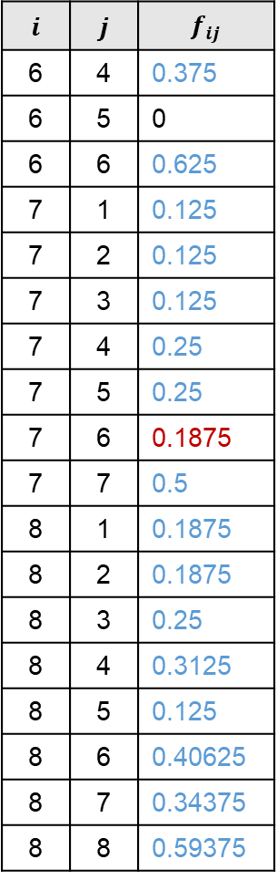
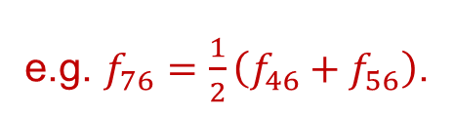
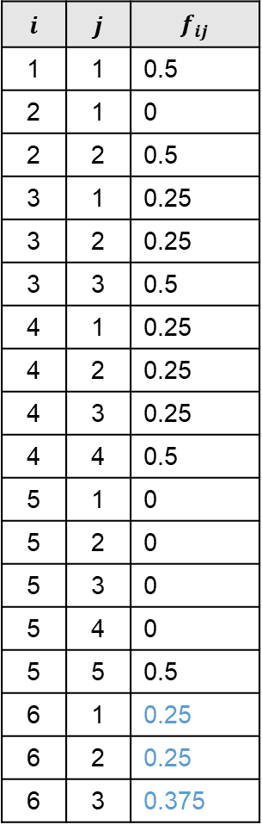

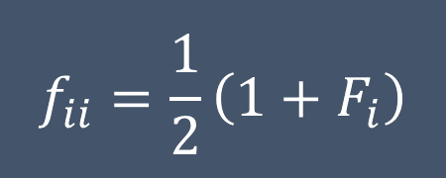

Example 2
Use these to complete the rest.
$$i$$ | $$j$$ | $$f_{ij}$$
1 | 1 | 0.5
2 | 1 | 0
2 | 2 | 0.5
3 | 1 | 0.25
3 | 2 | 0.25
3 | 3 | 0.5
4 | 1 | 0.25
4 | 2 | 0.25
4 | 3 | 0.25
4 | 4 | 0.5
5 | 1 | 0
5 | 2 | 0
5 | 3 | 0
5 | 4 | 0
5 | 5 | 0.5
6 | 1 | 0.25
6 | 2 | 0.25
6 | 3 | 0.375
$$i$$ | $$j$$ | $$f_{ij}$$
6 | 4 | 0.375
6 | 5 | 0
6 | 6 | 0.625
7 | 1 | 0.125
7 | 2 | 0.125
7 | 3 | 0.125
7 | 4 | 0.25
7 | 5 | 0.25
7 | 6 | 0.1875
7 | 7 | 0.5
8 | 1 | 0.1875
8 | 2 | 0.1875
8 | 3 | 0.25
8 | 4 | 0.3125
8 | 5 | 0.125
8 | 6 | 0.40625
8 | 7 | 0.34375
8 | 8 | 0.59375
1
2
$$f_{ii}=\frac{1}{2}\left(1+F_{i}\right)$$
3
4
5
$$F_{i}=f_{pq}$$
6
7
$$f_{ij}=\frac{1}{2}\left(f_{pj}+f_{qj}\right)$$
e.g. $f_{76}=\frac{1}{2}\left(f_{46}+f_{56}\right)$.
8

Slide 18
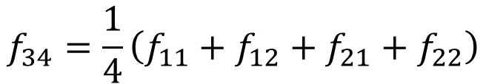
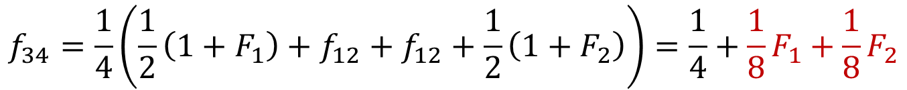

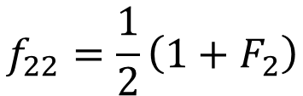
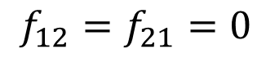
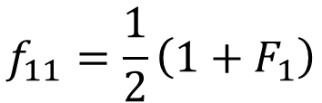
Example 1.1
What if 1 and 2 have inbreeding history?
1
2
$$f_{34}=\frac{1}{4}\left(f_{11}+f_{12}+f_{21}+f_{22}\right)$$
$$f_{11}=\frac{1}{2}\left(1+F_{1}\right)$$
3
4
$$f_{12}=f_{21}=0$$
$$f_{34}$$
$$f_{22}=\frac{1}{2}\left(1+F_{2}\right)$$
?
$$f_{34}=\frac{1}{4}\left(\frac{1}{2}\left(1+F_{1}\right)+f_{12}+f_{12}+\frac{1}{2}\left(1+F_{2}\right)\right)=\frac{1}{4}+\frac{1}{8}F_{1}+\frac{1}{8}F_{2}$$

Slide 19
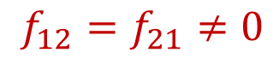
Example 1.2
What if 1 and 2 have inbreeding history and they are also related?
1
2
$$f_{34}=\frac{1}{4}\left(f_{11}+f_{12}+f_{21}+f_{22}\right)$$
$$f_{11}=\frac{1}{2}\left(1+F_{1}\right)$$
3
4
$$f_{12}=f_{21}≠0$$
$$f_{34}$$
$$f_{22}=\frac{1}{2}\left(1+F_{2}\right)$$
?
$$f_{34}=\frac{1}{4}\left(\frac{1}{2}\left(1+F_{1}\right)+f_{12}+f_{12}+\frac{1}{2}\left(1+F_{2}\right)\right)=\frac{1}{4}+\frac{1}{8}F_{1}+\frac{1}{8}F_{2}+\frac{1}{2}f_{12}$$

Slide 20
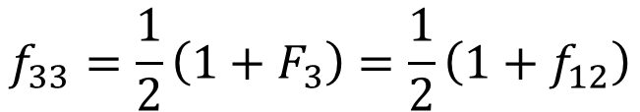
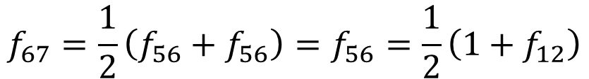
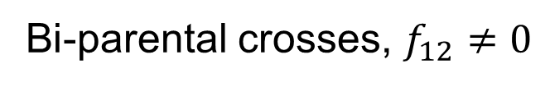
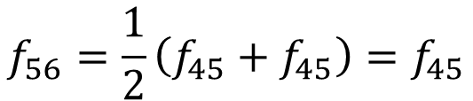
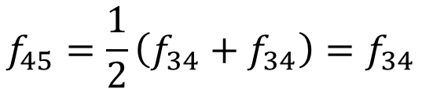
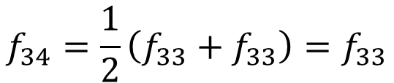
Example 3
Bi-parental crosses, $f_{12}≠0$
1
2
$$f_{33}=\frac{1}{2}\left(1+F_{3}\right)=\frac{1}{2}\left(1+f_{12}\right)$$
3
$$f_{34}=\frac{1}{2}\left(f_{33}+f_{33}\right)=f_{33}$$
$$f_{45}=\frac{1}{2}\left(f_{34}+f_{34}\right)=f_{34}$$
4
5
$$f_{56}=\frac{1}{2}\left(f_{45}+f_{45}\right)=f_{45}$$
6
7
$$f_{67}=\frac{1}{2}\left(f_{56}+f_{56}\right)=f_{56}=\frac{1}{2}\left(1+f_{12}\right)$$

Slide 21
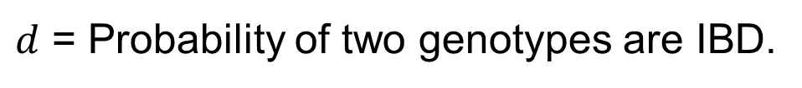
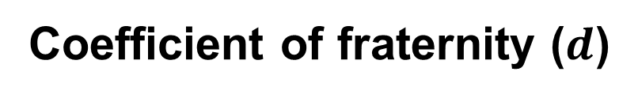
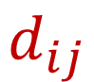
Coefficient of fraternity ($d$)
$d$ = Probability of two genotypes are IBD.
p
q
r
s
$$d_{ij}$$
i
j

Slide 22






Coefficient of fraternity ($d$)
$d$ = Probability of two IBD genotypes.
$$f_{ps}$$
$$f_{pr}$$
$$f_{qs}$$
$$f_{qr}$$
p
q
r
s
p
q
r
s
$$d_{ij}$$
$$d_{ij}$$
i
j
i
j
$$d_{ij}=f_{pr}f_{qs}+f_{ps}f_{qr}$$
Only possible if the parents are related.

Slide 23



Example 2
1. Fill in the known and easy ones.
$$i$$ | $$j$$ | $$f_{ij}$$ | $$d_{ij}$$
1 | 1 | 0.5 | 1
2 | 1 | 0 | 0
2 | 2 | 0.5 | 1
3 | 1 | 0.25 | 0
3 | 2 | 0.25 | 0
3 | 3 | 0.5 | 1
4 | 1 | 0.25 | 0
4 | 2 | 0.25 | 0
4 | 3 | 0.25
4 | 4 | 0.5 | 1
5 | 1 | 0 | 0
5 | 2 | 0 | 0
5 | 3 | 0 | 0
5 | 4 | 0 | 0
5 | 5 | 0.5 | 1
6 | 1 | 0.25 | 0
6 | 2 | 0.25 | 0
6 | 3 | 0.375
$$i$$ | $$j$$ | $$f_{ij}$$ | $$d_{ij}$$
6 | 4 | 0.375
6 | 5 | 0 | 0
6 | 6 | 0.625 | 1
7 | 1 | 0.125 | 0
7 | 2 | 0.125 | 0
7 | 3 | 0.125
7 | 4 | 0.25
7 | 5 | 0.25 | 0
7 | 6 | 0.1875
7 | 7 | 0.5 | 1
8 | 1 | 0.1875 | 0
8 | 2 | 0.1875 | 0
8 | 3 | 0.25
8 | 4 | 0.3125
8 | 5 | 0.125 | 0
8 | 6 | 0.40625
8 | 7 | 0.34375
8 | 8 | 0.59375 | 1
1
2
3
4
5
With itself, $d_{ii}=1$.
Assume $d_{ij}=0$ if $i≠j$ and $i/j$ does not have known parents.
6
7
8

Slide 24




Example 2
2. Compute the rest with this formula.
$$i$$ | $$j$$ | $$f_{ij}$$ | $$d_{ij}$$
1 | 1 | 0.5 | 1
2 | 1 | 0 | 0
2 | 2 | 0.5 | 1
3 | 1 | 0.25 | 0
3 | 2 | 0.25 | 0
3 | 3 | 0.5 | 1
4 | 1 | 0.25 | 0
4 | 2 | 0.25 | 0
4 | 3 | 0.25 | 0.25
4 | 4 | 0.5 | 1
5 | 1 | 0 | 0
5 | 2 | 0 | 0
5 | 3 | 0 | 0
5 | 4 | 0 | 0
5 | 5 | 0.5 | 1
6 | 1 | 0.25 | 0
6 | 2 | 0.25 | 0
6 | 3 | 0.375 | 0.125
$$i$$ | $$j$$ | $$f_{ij}$$ | $$d_{ij}$$
6 | 4 | 0.375 | 0.125
6 | 5 | 0 | 0
6 | 6 | 0.625 | 1
7 | 1 | 0.125 | 0
7 | 2 | 0.125 | 0
7 | 3 | 0.125 | 0
7 | 4 | 0.25 | 0
7 | 5 | 0.25 | 0
7 | 6 | 0.1875 | 0
7 | 7 | 0.5 | 1
8 | 1 | 0.1875 | 0
8 | 2 | 0.1875 | 0
8 | 3 | 0.25 | 0.0625
8 | 4 | 0.3125 | 0.0625
8 | 5 | 0.125 | 0
8 | 6 | 0.40625 | 0.140625
8 | 7 | 0.34375 | 0.09375
8 | 8 | 0.59375 | 1
1
2
$$d_{ij}=f_{pr}f_{qs}+f_{ps}f_{qr}$$
3
4
5
e.g.
$d_{34}=f_{11}f_{22}+f_{12}f_{21}$
$d_{36}=f_{13}f_{24}+f_{14}f_{23}$
6
7
8

Slide 25


Some known values for $f$ and $d$
Relationship | $$f$$ | $$d$$
Parent - progeny | 1/4 | 0
Half siblings | 1/8 | 0
Full siblings | 1/4 | 1/4
First cousins | 1/16 | 0
Monozygotic twins | 1/2 | 1
These values assume no inbreeding history.

Slide 26
Applications of IBD
QTL linkage mapping
Marker genotype imputation and phasing
Genetic relationship matrix (GRM) calculation
Breeding and evolutionary history understanding
Population demographic inference
Genealogy and ancestry identification
Forensics

Slide 27

IBD in QTL linkage mapping
Genotype a bi-parental population
Compute P(IBD) using hidden Markov model
P(IBD) with founder 1
ID1 A G C A
ID2 A C C T
ID3 G C C T
ID1 1 1 .5 1
ID2 1 1 .5 0
ID3 0 0 .5 0
What is a hidden Markov model (HMM)?
As you leave your home every morning, you look up to the sky and wonder if it will be rainy or sunny later in the day.
Assume that the weather forms a Markov chain, you pause at your front door for a second. You check the cloud cover, feel the breeze, look around and try to remember what happened in the last few days. Then you decide if you should pack an umbrella.
Cloud, breeze = marker genotype
Weather = founder IBD

Slide 28

IBD in QTL linkage mapping (multiparental population)
Similarly, P(IBD) can also be calculated in multi-parental populations.
Here is an example showing P(IBD) in a RIL from the Arabidopsis 19-founder MAGIC population (Kover et al 2009).

Slide 29
IBD in marker genotype imputation and phasing
This process is similar to the previous application in QTL linkage mapping.
It starts with using HMM to identify (phase) the parent origin of each allele.
Then, it uses the phase information to fill in (impute) the missing data.
ID1 | A | G | C | A
 | A | G | C | A
Phase
ID2 | A | C | C | T
 | A | C | C | T
ID1 A/A G/G C/C A/A
ID2 A/A C/C C/C T/T
ID3 G/A G/C C/C A/T
ID4 G/G N/N C/C T/T
ID5 A/G C/C C/C N/N
ID3 | A | G | C | A
 | G | C | C | T
ID4 | G | N | C | T
 | G | N | C | T
ID5 | A | G | C | N
 | G | G | C | N
Impute
P1 | A | G | C | A
 | A | G | C | A
P2 | G | C | C | T
 | G | C | C | T

Slide 30


IBD in marker genotype imputation and phasing – common software
STITCH (Davies et al 2016)
FILLIN/FSFHap (Swarts et al 2014)
AlphaImpute (Hickey et al 2012)
Beagle (Browning et al 2021)
Many options, but they are fundamentally similar – identify founder haplotype, fill in missing data from others that shared the same haplotype.

Slide 31

IBD in genetic relationship matrix (GRM) calculation
1
2
Pedigree-based additive genetic relationship matrix (A)
1 2 3 4 5 6
1 1.00 0.00 0.50 0.50 0.50 0.50
2 0.00 1.00 0.50 0.50 0.50 0.50
3 0.50 0.50 1.00 0.50 0.75 0.75
4 0.50 0.50 0.50 1.00 0.75 0.75
5 0.50 0.50 0.75 0.75 1.25 0.75
6 0.50 0.50 0.75 0.75 0.75 1.25
3
4
5
6
Coefficient of additive genetic covariance between individuals, $A_{ij}=2f_{ij}$.
Recall that $f_{ii}=\frac{1}{2}\left(1+F_{i}\right)$, so the diagonals are $1+F_{i}$.
Note: A is a symmetric matrix, $A_{ij}=A_{ji}$.
Similar can be done for the dominance GRM.

Slide 32

IBD in breeding and evolutionary history understanding
This highlights the prevalence of a single variety in the Chinese maize breeding history.
Li et al (2019) The HuangZaoSi maize genome provides insights into genomic variation and improvement history of maize.

Slide 33

IBD in breeding and evolutionary history understanding
Similar work in cattle, this shows the genome-wide Holstein introgression in Danish cattle.
Zhang et al. (2018) Human-mediated introgression of haplotypes in a modern dairy cattle breed

Slide 34

IBD in population demographic inference
Historical migration patterns
Population admixture
Genetic diseases
Saada et al. (2020) Identity-by-descent detection across 487,409 British samples reveals fine scale population structure and ultra-rare variant associations

Slide 35



IBD in genealogy and ancestry identification
IBD haplotype inference as a commercial product.

Slide 36

IBD in forensics
Matching IBD segments between a sample and database/relatives.
Data privacy and public database.
Erlich et al (2018)

Slide 37
Challenges in working with IBD
Genotypic data quality (errors, missing data)
Complicated population demography
Assumptions in estimating coefficients
Small sample size
Recombination
Limitation in computational power
Ethical concerns in data usage
It is average, at best

Slide 38
Identity-by-state (IBS)
Two of the same alleles regardless of their ancestral origins are considered identical by state.
If the parents are “unrelated”, then they are IBS.
If the parents are related, then they are IBD.
If two alleles are IBD, they are also IBS.
But, if two alleles are IBS, they are not necessarily IBD.

Slide 39
Example 1
IBS is often described in the context of molecular markers.
Biallelic single nucleotide polymorphisms (SNP) vs multiallelic gene.
For example, there are 4 alleles in the founders.
Some generations later, we genotype the descendants and find these polymorphisms.
AGCTCG
AGCT-G
ATCTCG
ATCT-G
AGC
AGC
AGC
ATC
ATC
TCG
TCG
T-G
T-G
T-G
AGCTCG
AGCTCG
AGCT-G
ATCTCG
ATCTCG
IBS
IBD
IBS
IBS
IBS
IBD

Slide 40




Example 2
Ability to feed on poisonous milkweed
IBS can happen due to convergent evolution.
Environment 1
Environment 2
A
A
C
A
A
C
C
C
Stern (2013)

Slide 41

IBS, in a nutshell
SNP A
SNP A
https://knowyourmeme.com/memes/spider-man-pointing-at-spider-man

Slide 42
Applications of IBS
Genetic relationship matrix (GRM) calculation
Linkage disequilibrium identification
IBD inference
Association mapping

Slide 43



IBS in genetic relationship matrix (GRM) calculation
Genomic-based (vs pedigree-based)
Suppose we have a genotype matrix (X) with 6 individuals and 10 markers,
m01 m02 m03 m04 m05 m06 m07 m08 m09 m10
id1 2 2 0 0 0 2 0 0 2 2
id2 2 2 0 0 0 2 2 2 0 2
id3 0 2 0 2 0 0 0 2 0 0
id4 0 0 0 0 2 0 0 0 0 0
id5 2 0 2 2 0 0 2 2 0 0
id6 0 0 2 0 2 0 0 0 0 0
id1 id2 id3 id4 id5 id6
id1 2.50 1.00 -0.65 -0.65 -1.25 -0.95
id2 1.00 2.20 -0.35 -1.25 -0.05 -1.55
id3 -0.65 -0.35 1.60 -0.20 0.10 -0.50
id4 -0.65 -1.25 -0.20 1.60 -0.80 1.30
id5 -1.25 -0.05 0.10 -0.80 2.20 -0.20
id6 -0.95 -1.55 -0.50 1.30 -0.20 1.90
we can calculate the K matrix as
$$K=\frac{WW′}{\sum{2p_{j}(1−p_{j})}}$$
where
$$W_{ij}=X_{ij}−{2p}_{j}$$
and $p_{j}$ is the allele frequency for $j^{th}$ marker.

Slide 44





Additive GRM
VanRaden (2008) method 1
Endelman and Jannink (2012) rrBLUP
Additive GRM is often denoted as $K_{A}$.
$$K_{A}=\frac{WW′}{\sum{2p_{j}(1−p_{j})}} where W_{ij}=X_{ij}−2p_{j}$$
Given a genotype matrix $X$ with $n$ rows of individuals and $m$ columns of markers coded as 0/1/2, there are several variants of how $K_{A}$ can be calculated.
VanRaden (2008) method 2
Yang et al. (2011) GCTA
$$K_{A}=\frac{WW′}{m} where W_{ij}=\frac{X_{ij}−2p_{j}}{\sqrt{2p_{j}\left(1−p_{j}\right)}}$$
Speed et al. (2012) LDAK
$$K_{A}=\frac{WW′}{m} where W_{ij}=\frac{X_{ij}−2p_{j}}{\sqrt{2p_{j}\left(1−p_{j}\right)}}∙\sqrt{\frac{ω_{j}m}{\sum{ω_{j}}}}$$
Note: $ω_{j}$ is the marker weight adjusted by LD.

Slide 45




Dominance GRM
Dominance GRM is often denoted as $K_{D}$.
Su et al. (2012)
$$H_{ij}=\left\{\begin{matrix}0 if X_{ij}=0 \\ \begin{aligned}1 if X_{ij}=1 \\ 0 if X_{ij}=2\end{aligned}\end{matrix}\right.$$
$$K_{D}=\frac{WW′}{\sum{\left(2p_{j}(1−p_{j})\right)\left(1−2p_{j}(1−p_{j})\right)}} where W_{ij}=H_{ij}−2p_{j}\left(1−p_{j}\right)$$
Zhu et al. (2015) GCTA
$$H_{ij}=\left\{\begin{matrix}0 if X_{ij}=0 \\ \begin{aligned}2p_{j} if X_{ij}=1 \\ 4p_{j}−2 if X_{ij}=2\end{aligned}\end{matrix}\right.$$
$$K_{D}=\frac{WW′}{m} where W_{ij}=\frac{H_{ij}−2{p_{j}}^{2}}{2p_{j}\left(1−p_{j}\right)}$$

Slide 46


Uses of GRM
Typically, any quantitative trait can be partitioned into mean ($μ$), genetic ($g$) and residual ($e$) effects.
$$Y=μ+g+e$$
To do that, we need to know the relationships of $g$ and $e$ among the individuals in a population.
$e$ is assumed uncorrelated among the individuals, so the relationship is just an identity matrix.
$g$ is assumed correlated among the individuals, and the relationship is the GRM.
So, GRM is important in modern quantitative genetics – principal components, GWAS, genomic prediction, variance components, etc.

Slide 47

IBS in linkage disequilibrium (LD) identification
LD blocks
LD in a teosinte population
A
C
A
T
G
C
G
G
T
G
A
C
A
C
C
LD decay
LD
Weber et al (2007)
Distance

Slide 48






LD calculation
Several methods for calculating LD
1
$$D=p_{AB}−p_{A}p_{B}$$
$$D_{max}=\left\{\begin{matrix}\min\left(p_{A}p_{B},\left(1−p_{A}\right)\left(1−p_{B}\right)\right)if D<0 \\ \min\left(p_{A}\left(1−p_{B}\right),p_{B}\left(1−p_{A}\right)\right)if D>0\end{matrix}\right.$$
$$D^{′}=\frac{D}{D_{max}}$$
2
$$r^{2}=\frac{D^{2}}{p_{A}(1−p_{A})p_{B}(1−p_{B})}$$
3
Note:
$$−1≤D^{′}≤1$$
$$0≤r^{2}≤1$$

Slide 49





LD calculation
$$D=p_{AB}−p_{A}p_{B}=0.50−0.65×0.60=0.11$$
 | B | b
A | 50 | 15
a | 10 | 25
$$D_{max}=\left\{\begin{matrix}\min\left(p_{A}p_{B},\left(1−p_{A}\right)\left(1−p_{B}\right)\right)if D<0 \\ \min\left(p_{A}\left(1−p_{B}\right),p_{B}\left(1−p_{A}\right)\right)if D>0\end{matrix}\right.$$
$$p_{A}=\frac{65}{100}=0.65$$
$$D_{max}=\min\left(0.65×0.40, 0.60×0.35\right)=0.21$$
$$D^{′}=\frac{D}{D_{max}}=\frac{0.11}{0.21}=0.52$$
$$p_{B}=\frac{60}{100}=0.60$$
$$r^{2}=\frac{D^{2}}{p_{A}(1−p_{A})p_{B}(1−p_{B})}=\frac{{0.11}^{2}}{0.65×0.35×0.60×0.40}=0.22$$
$$p_{AB}=\frac{50}{100}=0.50$$

Slide 50
LD calculation
In numeric genotype (inbred)
 | B | b
A | 50 | 15
a | 10 | 25
marker_1 | marker_2 | count
0 | 0 | 25
0 | 2 | 10
2 | 0 | 15
2 | 2 | 50
$$p_{A}=\frac{65}{100}=0.65$$
$$p_{B}=\frac{60}{100}=0.60$$
This can be computed easily in R
marker_1 <- rep(c(0,0,2,2), c(25, 10, 15, 50))
marker_2 <- rep(c(0,2,0,2), c(25, 10, 15, 50))
cor(marker_1, marker_2)^2
# 0.2216117
$$p_{AB}=\frac{50}{100}=0.50$$

Slide 51

Association mapping
GWAS in barley varieties
GRM to correct for genetic background effect.
Biallelic SNP testing.
LD between significant SNP and candidate genes.
Cockram et al (2010)

Slide 52
Challenges in working with IBS
Genotypic data quality (errors, missing data)
Complicated population demography
Small sample size
Limitation in computational power
Lack of genealogical support for biological significance

Slide 53
Genetic distance
A measure of genetic divergence between populations or sub-populations.
Common causes:
Selection
Mutation
Drift

Slide 54

Selection
Balancing
Disruptive
Directional/truncation
Quantitative trait
Gaynor et al (2017)

Slide 55

Mutation
Novel variation by interfering with the DNA replication and repair system
Natural mutation
Inherent mutation rate
Long term divergence
Can be important for crop evolution
Induced mutation
Random: mutagen like EMS, γ-ray
Targeted: transgenic, gene editing
Common approach for breeding vegetable and ornamental
E.g. tga1 in maize
Wang et al (2005)

Slide 56


Drift
Unpredictable.
Follows a multinomial distribution.
Binomial distribution in the case of two alleles.
Mean = $p_{i}$.
Variance = $\frac{p_{i} (1−p_{i})}{2N_{i+1}}$.
In the absence of mutation, $F_{t}=1−{\left(1−\frac{1}{2N}\right)}^{t}$.
Heterozygosity, $H_{t}=1−F_{t}={\left(1−\frac{1}{2N}\right)}^{t}$.
Alleles
1
2
3
4
1
1
1
2
3
3
1
1
1
3
1
1
1
1
Inbreeding

Slide 57




Wahlund effect
Under Hardy-Weinberg equilibrium (HWE), presence of subpopulations can reduce overall heterozygosity even without inbreeding.
$$H_{1+2}<H if p_{1}≠p_{2}$$
An example of how subpopulations arise
$H_{1+2}=$ combined heterozygosity
$H=$ overall heterozygosity
Flowers in the morning
Flowers in the afternoon

Slide 58







Wahlund effect (in equation form)
Under HWE, $P\left(AA\right)+P\left(Aa\right)+P\left(aa\right)=p^{2}+2p\left(1−p\right)+{\left(1−p\right)}^{2}=1$
Note:
$n$ is the population size
$p$ is the allele frequency
Heterozygosity is
$$H=2p\left(1−p\right)$$
Heterozygosities in subpopulation 1 and 2 are
$$H_{1}=2p_{1}\left(1−p_{1}\right)$$
$$H_{2}=2p_{2}\left(1−p_{2}\right)$$
Combined heterozygosity is the weighted average of $H_{1}$ and $H_{2}$
$$H_{1+2}=ω_{1}H_{1}+ω_{2}H_{2}$$
$$ω_{1}+ω_{2}=\frac{n_{1}}{n_{1}+n_{2}}+\frac{n_{2}}{n_{1}+n_{2}}=1$$
$$H_{1+2}=2ω_{1}p_{1}\left(1−p_{1}\right)+2ω_{2}p_{2}\left(1−p_{2}\right)$$
If $p_{1}=p_{2}$ then $H=H_{1+2}$

Slide 59



Wahlund effect (in visual form)
Population
Sub-population 1
Sub-population 2
AA
AA
AA
AA
AA
AA
Aa
Aa
Aa
Aa
Aa
Aa
Aa
Aa
Aa
Aa
Aa
Aa
Aa
Aa
Aa
Aa
aa
aa
aa
aa
aa
aa
aa
aa
aa
aa
aa
Observed heterozygosity
Observed allele frequency
Expected heterozygosity
$$H_{1+2}=\frac{4+12}{8+25}=0.48$$
$$p_{A}=\frac{6×2+\left(4+12\right)×1}{(8+25)×2}=0.42$$
$$H=2p_{A}\left(1−p_{A}\right)=0.49$$

Slide 60





Proof for Wahlund effect
Recall $H_{1+2}=2ω_{1}p_{1}\left(1−p_{1}\right)+2ω_{2}p_{2}\left(1−p_{2}\right)$
$$H_{1+2}=2ω_{1}p_{1}−2ω_{1}p_{1}^{2}+2ω_{2}p_{2}−2ω_{2}p_{2}^{2}$$
Overall heterozygosity is
$$H=2p\left(1−p\right)$$
and because
$$p=ω_{1}p_{1}+ω_{2}p_{2}$$
$$H=2\left(ω_{1}p_{1}+ω_{2}p_{2}\right)\left(1−\left(ω_{1}p_{1}+ω_{2}p_{2}\right)\right)$$
$$H=2ω_{1}p_{1} −2ω_{1}^{2}p_{1}^{2}−2ω_{1}ω_{2}p_{1}p_{2}+2ω_{2}p_{2}−2ω_{1}ω_{2}p_{1}p_{2}−2ω_{2}^{2}p_{2}^{2}$$
Expand the equation
$$H=2ω_{1}p_{1} −2ω_{1}^{2}p_{1}^{2}+2ω_{2}p_{2}−2ω_{2}^{2}p_{2}^{2}−4ω_{1}ω_{2}p_{1}p_{2}$$
Rearrange the terms
$$H=2ω_{1}p_{1} −2ω_{1}p_{1}^{2}+2ω_{1}p_{1}^{2}−2ω_{1}^{2}p_{1}^{2}+2ω_{2}p_{2}−2ω_{2}p_{2}^{2}+2ω_{2}p_{2}^{2}−2ω_{2}^{2}p_{2}^{2}−4ω_{1}ω_{2}p_{1}p_{2}$$
Tricks
$$H=H_{1+2}+2ω_{1}p_{1}^{2}−2ω_{1}^{2}p_{1}^{2}+2ω_{2}p_{2}^{2}−2ω_{2}^{2}p_{2}^{2}−4ω_{1}ω_{2}p_{1}p_{2}$$
Replace the terms
$$H=H_{1+2}+2ω_{1}p_{1}^{2}−2ω_{1}\left(1−ω_{2}\right)p_{1}^{2}+2ω_{2}p_{2}^{2}−2ω_{2}\left(1−ω_{1}\right)p_{2}^{2}−4ω_{1}ω_{2}p_{1}p_{2}$$
Tricks
$$H=H_{1+2}+2ω_{1}p_{1}^{2}−2ω_{1}p_{1}^{2}+2ω_{1}ω_{2}p_{1}^{2}+2ω_{2}p_{2}^{2}−2ω_{2}p_{2}^{2}+2ω_{1}ω_{2}p_{2}^{2}−4ω_{1}ω_{2}p_{1}p_{2}$$
Expand the equation
$$H=H_{1+2}+2ω_{1}ω_{2}p_{1}^{2}+2ω_{1}ω_{2}p_{2}^{2}−4ω_{1}ω_{2}p_{1}p_{2}$$
Simplify the equation
$$H=H_{1+2}+2ω_{1}ω_{2}\left(p_{1}^{2}+p_{2}^{2}−2p_{1}p_{2}\right)$$
Rearrange the terms
$$H=H_{1+2}+2ω_{1}ω_{2}{\left(p_{1}−p_{2}\right)}^{2}$$
$$H_{1+2}<H if p_{1}≠p_{2}$$

Slide 61




$p_{x,ij}$ and $p_{y,ij}$ are the frequencies of allele $j$ at locus $i$ in population $x$ and $y$.
$m$ is the number of markers.
How to compute genetic distance?
Roger’s distance (~ Euclidean)
$$D=\frac{1}{m}\sum_{i}{\sqrt{\frac{1}{2}\sum_{j}{{\left(p_{x,ij}−p_{y,ij}\right)}^{2}}}}$$
Special case: biallelic
$$D=\frac{1}{m}\sum_{i}{\left|p_{x,ij}−p_{y,ij}\right|}$$
Pop | A1 | A2 | A3
X | 0.2 | 0.5 | 0.3
Y | 0.3 | 0.1 | 0.6
Pop | B1 | B2 | B3
X | 0.4 | 0.2 | 0.4
Y | 0.4 | 0.5 | 0.1
$$D=\frac{1}{2}\left\{\sqrt{\frac{1}{2}\left[{\left(0.2−0.3\right)}^{2}+{\left(0.5−0.1\right)}^{2}+{\left(0.3−0.6\right)}^{2}\right]}+\sqrt{\frac{1}{2}\left[{\left(0.4−0.4\right)}^{2}+{\left(0.2−0.5\right)}^{2}+{\left(0.4−0.1\right)}^{2}\right]}\right\}$$
$$D=0.3303$$

Slide 62


$p_{x,ij}$ and $p_{y,ij}$ are the frequencies of allele $j$ at locus $i$ in population $x$ and $y$.
$m$ is the number of markers.
How to compute genetic distance?
Nei’s distance (Nei 1972)
$$D=−ln\left(\frac{\sum_{i}{\sum_{j}{p_{x,ij}p_{y,ij}}}}{\sqrt{\sum_{i}{\sum_{j}{p_{x,ij}^{2}}}∙\sum_{i}{\sum_{j}{p_{y,ij}^{2}}}}}\right)$$
Pop | A1 | A2 | A3
X | 0.2 | 0.5 | 0.3
Y | 0.3 | 0.1 | 0.6
Pop | B1 | B2 | B3
X | 0.4 | 0.2 | 0.4
Y | 0.4 | 0.5 | 0.1
$$D=−ln\left[\frac{0.2∙0.3+0.5∙0.1+0.3∙0.6+0.4∙0.4+0.2∙0.5+0.4∙0.1}{\sqrt{\left({0.2}^{2}+{0.5}^{2}+{0.3}^{2}+{0.4}^{2}+{0.2}^{2}+{0.4}^{2}\right)∙\left({0.3}^{2}+{0.1}^{2}+{0.6}^{2}+{0.4}^{2}+{0.5}^{2}+{0.1}^{2}\right)}}\right]$$
$$D=0.3132$$
There are many other ways to compute genetic distance that we will not cover here.

Slide 63



Wright’s F statistics, $F_{ST}$
In the presence of inbreeding, the genotype frequencies in a population are:
$$P\left(AA\right)=p^{2}+Fp\left(1−p\right)$$
$$P\left(Aa\right)=2p\left(1−p\right)\left(1−F\right)$$
$$P(aa)={\left(1−p\right)}^{2}+Fp\left(1−p\right)$$
In the presence of sub-populations, the genotype frequencies are:
$$P\left(AA\right)=p_{i}^{2}+F_{i}p_{i}\left(1−p_{i}\right)$$
$$P\left(Aa\right)=2p_{i}\left(1−p_{i}\right)\left(1−F_{i}\right)$$
$$P(aa)={\left(1−p_{i}\right)}^{2}+F_{i}p_{i}\left(1−p_{i}\right)$$
1
2
3
6
4
5

Slide 64






Wright’s F statistics, $F_{ST}$
Let the heterozygosity of sub-population $i$ be the same as the population, we have
$$2p_{i}\left(1−p_{i}\right)\left(1−F_{i}\right)=2p\left(1−p\right)\left(1−F\right)$$
$$\frac{\left(1−F\right)}{\left(1−F_{i}\right)}=\frac{2p_{i}\left(1−p_{i}\right)}{2p\left(1−p\right)}$$
Rearrange the terms
$$\frac{\left(1−F\right)}{\left(1−F_{i}\right)}=1−F_{ST,i}$$
Tricks
$$F_{ST,i}=1−\frac{2p_{i}\left(1−p_{i}\right)}{2p\left(1−p\right)}$$
$$\left(1−F\right)=\left(1−F_{ST,i}\right)\left(1−F_{i}\right)$$
Rearrange the terms
$F_{IT}$ is the population (overall) inbreeding coefficient.
$F_{IS}$ is the sub-population inbreeding coefficient.
$F_{ST}$ is the fixation index, i.e. population differentiation.
$$\left(1−F_{IT}\right)=\left(1−F_{ST}\right)\left(1−F_{IS}\right)$$
0?

Slide 65


Interpreting $F_{ST}$ values
$F_{ST}$ ranges from 0 to 1, with 0 being no differentiation (panmixia) and 1 being complete differentiation.
Some literature may suggest the following as a rough guideline, but it is also important to consider genotyping method, population size, genetic diversity and mutation rate.
Moderate, 0.05 to 0.15
Very great, > 0.25
Little, < 0.05
Great, 0.15 to 0.25

Slide 66









Alternative ways to compute $F_{ST}$
$$F_{ST}=\frac{1}{n}\sum{F_{ST,i}}$$
Overall $F_{ST}$ while ignoring sub-population size differences.
$$F_{ST}=\frac{Var\left(p^{′}\right)}{p(1−p)}$$
Can be derived from the above.
Note that $Var\left(p^{′}\right)$ is the variance of sub-population allele frequencies.
$$F_{ST,i}=1−{\left(1−\frac{1}{2N_{i}}\right)}^{t}$$
$F_{ST}$ for sub-population under drift alone.
Note that $N_{i}$ is the sub-population size and $t$ is the number of generation.
Notice the similarity to inbreeding.
$$F_{ST,i}=\frac{π_{b}−π_{w,i}}{π_{b}}$$
$π_{b}$ is the nucleotide diversity (average number of pairwise difference) between sub-pops. $π_{w,i}$ is the nucleotide diversity within sub-pop $i$.
$$F_{ST,i}=\frac{M_{w,i}−M_{b}}{1−M_{b}}$$
$M$ is the average allele matches (Weir and Goudet 2017).
And many more methods not described here.

Slide 67















How to derive $F_{ST}=\frac{Var(p^{′})}{p(1−p)}$
Using $n=2$ as example,
$$F_{ST}=\frac{1}{2}\sum{F_{ST,i}}$$
$$=\frac{1}{2}\left(\frac{p_{1}^{2}+p_{2}^{2}+{2p}^{2}−4p\left(\frac{p_{1}+p_{2}}{2}\right)}{p\left(1−p\right)}\right)$$
$$=\frac{1}{2}\left(1−\frac{p_{1}\left(1−p_{1}\right)}{p\left(1−p\right)}+1−\frac{p_{2}\left(1−p_{2}\right)}{p\left(1−p\right)}\right)$$
$$=\frac{1}{2}\left(\frac{p_{1}^{2}+p_{2}^{2}+{2p}^{2}−{2pp}_{1}−{2pp}_{2}}{p\left(1−p\right)}\right)$$
$$=\frac{1}{2}\left(\frac{p\left(1−p\right)−p_{1}\left(1−p_{1}\right)+p\left(1−p\right)−p_{2}\left(1−p_{2}\right)}{p\left(1−p\right)}\right)$$
$$=\frac{1}{2}\left(\frac{p_{1}^{2}−{2pp}_{1}+p^{2}+p_{2}^{2}{−{2pp}_{2}+p}^{2}}{p\left(1−p\right)}\right)$$
$$=\frac{1}{2}\left(\frac{2p+p_{1}^{2}+p_{2}^{2}−{2p}^{2}−p_{1}−p_{2}}{p\left(1−p\right)}\right)$$
$$=\frac{1}{2}\left(\frac{{\left(p_{1}−p\right)}^{2}+{\left(p_{2}−p\right)}^{2}}{p\left(1−p\right)}\right)$$
$$=\frac{1}{2}\left(\frac{p_{1}^{2}+p_{2}^{2}−{2p}^{2}}{p\left(1−p\right)}\right)$$
Note that $p_{1}+p_{2}=2p$
$$=\frac{1}{p(1−p)}\frac{1}{2}\sum{{(p_{i}−p)}^{2}}$$
$$=\frac{1}{2}\left(\frac{p_{1}^{2}+p_{2}^{2}+{2p}^{2}−{4p}^{2}}{p\left(1−p\right)}\right)$$
$$=\frac{Var(p^{′})}{p(1−p)}$$

Slide 68




$$Q_{ST}$$
$Q_{ST}$ is a measure of population differentiation in quantitative traits.
$$Q_{ST}=\frac{V_{G,between}}{V_{G,between}+{2V}_{G,within}}$$
Figure 1. The distribution of neutral $F_{ST}$ and $Q_{ST}$. Each value in these histograms is derived from a single neutral locus or a single neutral trait in an island model with 10 demes sampled. The solid lines are the $χ^{2}$ distribution predicted by Lewontin & Krakauer (1973) and are the same in both figures. For these simulations, the local population size was N = 100, and the migration rate was m = 0.05. The traits were controlled by five unlinked loci with mutational effects chosen from an exponential distribution.
Whitlock (2008)

Slide 69



$Q_{ST}$ vs $F_{ST}$
$Q_{ST}$vs $F_{ST}$comparison for identifying possible selection.
Figure 6. Comparing a single $Q_{ST}$ value to the distribution of $F_{ST}$. The $Q_{ST}$ value for Trait 1 is greater than the mean $F_{ST}$ (= 0.0475), but it is not unrepresentative of the distribution of $F_{ST}$ values. It would be quite likely to generate a $Q_{ST}$ value like $Q_{ST,1}$ from a neutral trait. Trait 2 has a $Q_{ST}$ value that is in the tail of the distribution of $F_{ST}$; this trait has a $Q_{ST}$ value that would be very unusual for a neutral trait.
Whitlock (2008)

Slide 70




Example 1a
Ind | Sub-pop | Marker
1 | A | 2
2 | A | 1
3 | A | 2
4 | A | 1
5 | B | 0
6 | B | 0
7 | B | 1
8 | B | 1
1. Make all possible pairwise comparisons within sub-pop A.
$$∆_{ij}$$
$$π_{w,1}=\frac{∆_{12}+∆_{13}+∆_{14}+∆_{23}+∆_{24}+∆_{34}}{6}=\frac{1+0+1+1+0+1}{6}=\frac{2}{3}$$
2. Make all possible pairwise comparisons between sub-pop A and B.
$$π_{b}=\frac{∆_{15}+∆_{16}+∆_{17}+∆_{18}+∆_{25}+∆_{26}+∆_{27}+∆_{28}+∆_{35}+∆_{36}+∆_{37}+∆_{38}+∆_{45}+∆_{46}+∆_{47}+∆_{48}}{16}$$
$$π_{b}=\frac{2+2+1+1+1+1+0+0+2+2+1+1+1+1+0+0}{16}=1$$
$$F_{ST,i}=\frac{π_{b}−π_{w,i}}{π_{b}}$$
3. Apply the formula.
What are $π_{w,2}$ and $F_{ST,2}$?
$$F_{ST,1}=\frac{1−\frac{2}{3}}{1}=\frac{1}{3}$$
This method is biased when the sub-population sizes are different.

Slide 71




Example 1b
Ind | Sub-pop | Marker
1 | A | 2
2 | A | 1
3 | A | 2
4 | A | 1
5 | B | 0
6 | B | 0
7 | B | 1
8 | B | 1
1. Compute all pairwise matches within sub-pop A.
$$m_{ij}$$
$$M_{w,1}=\frac{m_{12}+m_{13}+m_{14}+m_{23}+m_{24}+m_{34}}{6}=\frac{\frac{1}{2}+1+\frac{1}{2}+\frac{1}{2}+\frac{1}{2}+\frac{1}{2}}{6}=\frac{7}{12}$$
2. Make all possible pairwise comparisons between sub-pop A and B.
$$π_{b}=\frac{m_{15}+m_{16}+m_{17}+m_{18}+m_{25}+m_{26}+m_{27}+m_{28}+m_{35}+m_{36}+m_{37}+m_{38}+m_{45}+m_{46}+m_{47}+m_{48}}{16}$$
$$M_{b}=\frac{0+0+\frac{1}{2}+\frac{1}{2}+\frac{1}{2}+\frac{1}{2}+\frac{1}{2}+\frac{1}{2}+0+0+\frac{1}{2}+\frac{1}{2}+\frac{1}{2}+\frac{1}{2}+\frac{1}{2}+\frac{1}{2}}{16}=\frac{3}{8}$$
$$F_{ST,i}=\frac{M_{w,i}−M_{b}}{1−M_{b}}$$
3. Apply the formula.
What are $M_{w,2}$ and $F_{ST,2}$?
$$F_{ST,1}=\frac{\frac{7}{12}−\frac{3}{8}}{1−\frac{3}{8}}=\frac{1}{3}$$

Slide 72
Applications of genetic distance
Identifying the impact of selection and breeding.
Understanding evolution from a population genetics angle.
Phylogenetics.
Data encryption.

Slide 73



Identifying the impact of selection and breeding
Selection evidence from genome-wide $F_{ST}$.
Qi et al (2013)
Figure 3. Highly divergent regions (top 5%; F_{ST}≥ 0.57) and nonsynonymous SNPs (top 5%; F_{ST} ≥ 0.70) between the East Asian and Eurasian groups. Green vertical bars higher than the dashed line (F_{ST} = 0.70) indicate highly divergent regions; purple dots indicate highly divergent nonsynonymous SNPs.

Slide 74


Identifying the impact of selection and breeding
$F_{ST}$may not always produce selection evidence.
POLLED locus – simple trait
PLAG1 locus – complex trait
Kemper et al (2014)

Slide 75

Understanding evolution from a population genetics angle
Example of isolation-by-distance.
Genetic distance vs geographical distance.
Higher dispersal distance in Florida Scrub-Jay females than males.
At short distance, the males are more genetically similar to each other than the females.
Aquillon et al (2017)

Slide 76


Landscape genetics
The relationship between genetic distance and geographical distance is not that straightforward.
It also depends on the landscape, which determines how much gene flow vs drift between sub populations.
van Strien et al (2015)

Slide 77


Phylogenetics
Phylogenetic trees are built from distance matrix.
Randi et al (1991)

Slide 78



Data encryption
Conversion of genomic markers into distances from reference individuals as a form of data encryption.
Potential for use in breeding in terms of data sharing.
Kim et al (2019)
Zhao et al (2024)

Slide 79

Challenges in working with genetic distance
Distance choice
Genotypic data quality (errors, missing data)
Assumptions in evolution rate, molecular clock, etc
Genetic marker type: SNP, InDel, SSR, etc
Statistical significance threshold (e.g. $F_{ST}$)

Slide 80

Population structure
A consequence of genetic divergence between sub-populations.
STRUCTURE
Principal component analysis (PCA)
Population structure control
PCA
Control
STRUCTURE
https://knowyourmeme.com/photos/1630278-why-is-it-when-something-happens-its-always-you-three

Slide 81
Principal component analysis (PCA)
Reduce dimensionality in data to a form that is easier to understand.
Given a set of genetic marker data, how can we quickly infer the population structure?
m01 m02 m03 m04 m05 m06 m07 m08 m09 m10
id1 2 0 0 0 0 0 2 0 0 2
id2 2 0 0 0 0 0 0 0 0 2
id3 2 0 0 2 0 0 2 0 0 2
id4 0 0 2 0 2 2 0 2 2 0
id5 0 2 2 0 2 0 0 0 0 0
id6 0 0 2 0 2 0 0 0 0 0
1. Calculate the correlations (e.g. K-matrix/GRM: genetic relationship matrix).

Slide 82

Principal component analysis (PCA)
1a. Calculate the allele frequencies and means.
m01 m02 m03 m04 m05 m06 m07 m08 m09 m10
id1 2 0 0 0 0 0 2 0 0 2
id2 2 0 0 0 0 0 0 0 0 2
id3 2 0 0 2 0 0 2 0 0 2
id4 0 0 2 0 2 2 0 2 2 0
id5 0 2 2 0 2 0 0 0 0 0
id6 0 0 2 0 2 0 0 0 0 0
 | m01 | m02 | m03 | m04 | m05 | m06 | m07 | m08 | m09 | m10
p | 0.50 | 0.17 | 0.50 | 0.17 | 0.50 | 0.17 | 0.33 | 0.17 | 0.17 | 0.50
$$μ=2p$$
1b. Center the marker data by the means.
m01 m02 m03 m04 m05 m06 m07 m08 m09 m10
id1 1 -0.33 -1 -0.33 -1 -0.33 1.33 -0.33 -0.33 1
id2 1 -0.33 -1 -0.33 -1 -0.33 -0.67 -0.33 -0.33 1
id3 1 -0.33 -1 1.67 -1 -0.33 1.33 -0.33 -0.33 1
id4 -1 -0.33 1 -0.33 1 1.67 -0.67 1.67 1.67 -1
id5 -1 1.67 1 -0.33 1 -0.33 -0.67 -0.67 -0.33 -1
id6 -1 -0.33 1 -0.33 1 -0.33 -0.67 -0.67 -0.33 -1

Slide 83









Principal component analysis (PCA)
1c. Multiply the matrix by its transpose.
id1 id2 id3 id4 id5 id6
id1 6.33 3.67 5.67 -6.33 -5.00 -4.33
id2 3.67 5.00 3.00 -5.00 -3.67 -3.00
id3 5.67 3.00 9.00 -7.00 -5.67 -5.00
id4 -6.33 -5.00 -7.00 13.00 2.33 3.00
id5 -5.00 -3.67 -5.67 2.33 7.67 4.33
id6 -4.33 -3.00 -5.00 3.00 4.33 5.00
$$M$$
$$×$$
$$M^{T}$$
$$=$$
$$n×p$$
$$n×n$$
$$p×n$$
1d. Divide the matrix by $\sum{2p\left(1−p\right)}$ [not actually needed for PCA].
id1 id2 id3 id4 id5 id6
id1 1.65 0.96 1.48 -1.65 -1.30 -1.13
id2 0.96 1.30 0.78 -1.30 -0.96 -0.78
id3 1.48 0.78 2.35 -1.83 -1.48 -1.30
id4 -1.65 -1.30 -1.83 3.39 0.61 0.78
id5 -1.30 -0.96 -1.48 0.61 2.00 1.13
id6 -1.13 -0.78 -1.30 0.78 1.13 1.30
$$K$$

Slide 84




Principal component analysis (PCA)
2. Perform eigen-decomposition ($Kv_{i}=λ_{i}v_{i}$).
-0.42 -0.06 -0.08 -0.14 0.79 -0.41
-0.30 0.02 -0.73 -0.05 -0.45 -0.41
-0.48 , -0.11 , 0.66 , 0.10 , -0.38 , -0.41
0.52 -0.74 0.01 -0.13 -0.01 -0.41
0.36 0.58 0.17 -0.57 -0.06 -0.41
0.32 0.31 -0.02 0.79 0.12 -0.41
8.08
2.21
0.93
0.44
0.34
0.00
$$v_{i}=$$
$$λ_{i}=$$
eigenvectors
eigenvalues
3. Plot the eigenvectors (principal components).
% variation explained ($PVE=\frac{λ_{i}}{\sum{λ_{i}}}∙100$).
PC1 explains 67% variation;
PC2 explains 18% variation.

Slide 85







Eigenvectors and eigenvalues
Remember from physics classes, a vector has direction and magnitude.
$$Kv_{i}=λ_{i}v_{i}$$
3
Think of $v_{i}$ as a slice of $K$, and $λ_{i}$ is the measure of how big the slice is.
2
Vector $\left[ \begin{matrix}1 \\ 1\end{matrix} \right]$ is represented by the red arrow.
1
0
1
2
3
Notice that $\left[ \begin{matrix}3 \\ 3\end{matrix} \right]=3\left[ \begin{matrix}1 \\ 1\end{matrix} \right]$, so the transformation changed the magnitude by 3 but not the direction.
Let’s try to transform the vector by $\left[ \begin{matrix}1 & 2 \\ 2 & 1\end{matrix} \right]$.
3
$$\left[ \begin{matrix}1 & 2 \\ 2 & 1\end{matrix} \right]×\left[ \begin{matrix}1 \\ 1\end{matrix} \right]=\left[ \begin{matrix}3 \\ 3\end{matrix} \right]$$
2
In that case, we can call $\left[ \begin{matrix}1 \\ 1\end{matrix} \right]$ as the eigenvector and $3$ as the corresponding eigenvalue.
1
0
1
2
3

Slide 86

Interpreting PCA plot
Clear separation on the first axis (PC1).
Finer-scale separation on PC2.
Price et al (2006)

Slide 87

Interpreting PCA plots
Extended Data Figure 1. PCA with genotyping-by-sequencing data of 19,778 varieties of domesticated barley sampled from the gene bank of the IPK9. The first six principal components are shown. Samples are colored according to geographic origin, row type or annual growth habit.
Jayakodi et al (2020)

Slide 88


STRUCTURE et al
These are software to model population admixture.
Typically uses Bayesian clustering methods ($Posterior=Prior×Observation$).
The model takes a prior ($K$ clusters of populations), adjusts it according to observation (allele frequencies) over many iterations, and produces the posterior (ancestry admixture estimate).
$$K=3$$

Slide 89







STRUCTURE in action: Welwitschia
powo.science.kew.org/taxon/urn%3Alsid%3Aipni.org%3 Anames%3A383591-1
Both ssp, $K=2$
ssp mirabilis, $K=4$
Jurgens et al (2021)
ssp namibiana, $K=4$

Slide 90






STRUCTURE in action: Eteline snapper
Andrews et al (2020)
E coruscans, $K=2$
E carbunculus, $K=2$
www.fishbase.se/summary/1385
www.fishbase.se/summary/Etelis-carbunculus

Slide 91

STRUCTURE in action: canine
Parker et al (2004)

Slide 92


ADMIXTURE in action: canine
Ramos-Madrigal et al (2021)

Slide 93


PCA + STRUCTURE + Phylogenetics in action: Wheat
www.teagasc.ie/crops/soil--soil-fertility/crop-n-p-k-advice/spring-cereals/spring-wheat/
Khadka et al (2020)

Slide 94

Population structure and spurious associations
“As population structure can result in spurious associations, it has constrained the use of association studies in human and plant genetics”.
Yu et al (2006)

Slide 95

Population structure control
Without control.
Commonly used in GWAS.
Many spurious results without control.
Control is not perfect.
With control.
Korte and Farlow (2013)

Slide 96
How to control for population structure?
Fix it
Avoid it
Structured association, e.g. MLM Q + K.
Genomic/delta control (GC/DC).
Stepwise regression.
Machine learning.
Functional validation.
Replicated studies.
Family-based, e.g. transmission disequilibrium test (TDT).
Mapping population design.

Slide 97



Mixed linear model, Q + K
Here is an “incorrect” GWAS model to illustrate the point.
$$y=μ+marker+Q+K+e$$
$Q$ = principal components
$K$ = GRM.
Yu et al (2006)

Slide 98




Genomic control (GC)
$$χ_{GC}^{2}=\frac{χ_{marker}^{2}}{λ}$$
Note: $λ=\frac{median\left(χ_{bg}^{2}\right)}{0.456}$ and for large n, $F_{df=1,n}≈χ_{df=1}^{2}$
Marker n Effect SE T-stat F-stat p
m01 100 1.5 0.5 3 9 0.003
m02 100 1.0 0.5 2 4 0.048
m03 100 0.8 0.4 2 4 0.048
m04 100 1.0 1.0 1 1 0.320
m05 100 0.5 0.5 1 1 0.320
m06 100 0.6 0.3 2 4 0.048
Using m03 to m06 as the background markers, $λ=\frac{2.5}{0.456}=5.482$.
With GC, then:
$F_{GC,m01}=\frac{9}{5.482}=1.642$ $p_{GC,m01}=0.203$
$F_{GC,m02}=\frac{4}{5.482}=0.730$ $p_{GC,m02}=0.395$

Slide 99



Delta control (DC)
$$χ_{GC}^{2}=χ_{marker}^{2}−δ^{2}$$
Note: $δ^{2}≈mean\left(χ_{bg}^{2}\right)$ and for large n, $F_{df=1,n}≈χ_{df=1}^{2}$
Marker n Effect SE T-stat F-stat p
m01 100 1.5 0.5 3 9 0.003
m02 100 1.0 0.5 2 4 0.048
m03 100 0.8 0.4 2 4 0.048
m04 100 1.0 1.0 1 1 0.320
m05 100 0.5 0.5 1 1 0.320
m06 100 0.6 0.3 2 4 0.048
Using m03 to m06 as the background markers, $δ^{2}=\frac{4+1+1+4}{4}=2.5$.
With DC, then:
$F_{DC,m01}=9−2.5=6.5$ $p_{DC,m01}=0.012$
$F_{DC,m02}=4−2.5=1.5$ $p_{DC,m02}=0.224$

Slide 100




Transmission disequilibrium test (TDT)
a
b
Identify $n$ individuals (progeny) with disease (simple trait).
Genotype $n$ progeny and $2n$ parents.
For each parent-progeny pair, classify the allele transmission.
RR
Rr
R
R
 | parent _R | parent _r
parent R_, transmits R | a | b
parent r_, transmits r | c | d
c
d
$$χ_{df=1}^{2}=\frac{{\left(b−c\right)}^{2}}{b+c}$$
Rr
rr
r
r
$$a+b+c+d=2n$$
Homozygous parents are uninformative, guaranteed to transmit same allele.
Heterozygous parents can transmit either allele, $b≈c$ if the marker is not linked to the causative locus.

Slide 101
Mapping population design
Populations under random mating
Uncommon.
Require us to have already studied the population structure.
Bi-parental populations
No population structure to worry about.
Recombinations between the two parental genomes.
QTL linkage mapping.
Limited allelic diversity.

Slide 102


Mapping population design
Typically involves ${n=2}^{x}$ founders, e.g. 4, 8, 16.
The founders are crossed at equal probabilities.
Minimal population structure.
An example with 4 founders.
All possible combinations:
(1 x 2) x (3 x 4)
(1 x 3) x (2 x 4)
(1 x 4) x (2 x 3)
Admixture analysis example:
Scott et al (2020)

Slide 103

MAGIC population in wheat with 16 founders
Figure 2. NDM population design and haplotypic diversity. (a) Pedigree showing the construction of 504 Recombinant Inbred Lines (RILs). One exemplar pedigree is highlighted to show how all 16 founders are intercrossed into each RIL. (b) Founder haplotype groups at 73,982 promoter-gene loci with SNP variation, where founders with the same haplotype have genotypic similarity fractions that exceed the corresponding threshold. (c) Pairwise similarity/dissimilarity between founders on chromosome 1A, determined using a dynamic programming algorithm to infer founder similarity and breakpoint position. Founders that are inferred to have similar haplotypes for each region are the same colour. (d) The total length of genomic blocks in NDM lines inferred to come from each founder; uncertain ancestry blocks have a maximum founder dosage of <90%. (e) Inferred founder dosage and ancestry mosaics across chromosome 1A for five example RILs, with founders colored as in (a).
Scott et al (2021)

Slide 104
Applications related to population structure
Association mapping (discussed previously).
Pan-genome assembly.
Selection mapping.
Precision medicine.

Slide 105



Population structure: need for a pan-genome
Hufford et al (2021)
High level of presence/absence variants.
Bias from alignment to a single reference genome.
McMullen et al (2009)

Slide 106

One of many benefits of pan-genome
Improvement to mapping power.
Coletta et al (2021)

Slide 107


Selection mapping
Selection/breeding results in population structure.
Selection evidence in winter wheat can be identified using env/eigen-GWAS approaches .
PC as trait
Year of variety release as trait
Sharma et al (2021)

Slide 108


Precision medicine (as explained in plants)
Assume the causative locus has not been identified.
Case 1: find an association at the left marker in Pop 1 > this marker gets it wrong in Pop 3 and 4.
Case 2: find an association at the right marker in Pop 3 > this marker gets it wrong in Pop 1 and 2.
Pop 1
Pop 2
2
Pop 3
1
If we know the population structure, then we know which marker is more appropriate for the populations.
PC2
4
3
Pop 4
PC1

Slide 109

Challenges in working with population structure
Population structure vs true positive
What is the right $K$?
Genotyping data quality (e.g. partially solved by pan-genome).
Small sample size
Statistical methods

Slide 110
Summary
Background. Why do we to study genetic relationship?
IBD. Definition: two alleles that have originated from the replication of one single allele in a previous generation ♦ coefficient of coancestry and fraternity – methods for calculating them.
IBS. Definition: two of the same alleles regardless of their ancestral origins ♦ IBS-based coefficients.
Genetic distance. Definition: a measure of genetic divergence between populations or sub-populations ♦ how do sub-populations diverge? ♦ methods for computing genetic distance.
Population structure. Definition: a consequence of genetic divergence between sub-populations ♦ common topics like PCA, admixture analysis, control approaches.
Examples
Applications
Challenges

Slide 111
Resources
Methods for calculating coefficient of coancestry
https://doi.org/10.1007/978-3-030-83940-6_11
https://www.genetic-genealogy.co.uk/supp/calc_inbreeding_coan.html
Relevant references
GRM: vanRaden (2008) Efficient methods to compute genomic predictions.
MLM Q + K: Yu et al (2006) A unified mixed-model method for association mapping that accounts for multiple levels of relatedness.
GC: Devlin and Roeder (1999) Genomic control for association studies.
DC: Gorroochurn et al (2011) An improved delta-centralization method for population stratification.
TDT: Spielman et al (1993) Transmission test for linkage disequilibrium: the insulin gene region and insulin-dependent diabetes mellitus (IDDM).
MAGIC: Cavanagh et al (2008) From mutations to MAGIC: resources for gene discovery, validation and delivery in crop plants.
Free online resources
https://github.com/cooplab/popgen-notes
https://felsenst.github.io/pgbook/pgbook.pdf
https://excellenceinbreeding.org/toolbox
Paid resources
Walsh and Lynch (2018) Evolution and selection of quantitative traits
Falconer and Mackay (1995) Introduction to quantitative genetics
Contact me
📧 cjyang90@uwalumni.com
🌐 cjyang-work.github.io
𝕏 @hataraku_cj

